Slide 1
Tut 5
Looping Constructs

Slide 2
Loops
There are three methods by way of which we can repeat a part of a program.
They are:
(a) Using a for statement
(b) Using a while statement
(c) Using a do-while statement

Slide 3
while loop
It is often the case in programming that you want to do something a fixed number of times.

Slide 4
while loop
Syntax-
initialise loop counter ;
while ( test loop counter using a condition )
{
do this ;
and this ;
increment loop counter ;
}

Slide 5
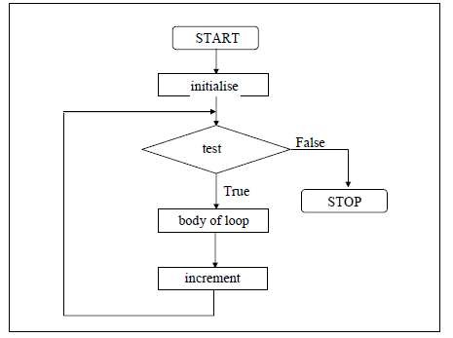
while loop
Syntax-
initialise loop counter ;
while ( test loop counter using a condition )
{
do this ;
and this ;
increment loop counter ;
}

Slide 6
while loop
The statements within the while loop would keep on getting executed till the condition being tested remains true.
When the condition becomes false, the control passes to the first statement after the body of the while loop.

Slide 7

while loop
The condition being tested may use relational or logical operators as shown in the following examples:

Slide 8
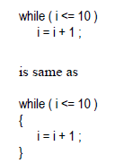
while loop
The statement within the loop may be a single line or a block of statements
In the first case , the paranthesis are optional

Slide 9
while loop
As a rule the while must test a condition that will eventually become false
Otherwise the loop would be executed forever, infinitely

Slide 10
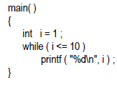
while loop
This is an infinite loop as i becomes fixed to 1

Slide 11
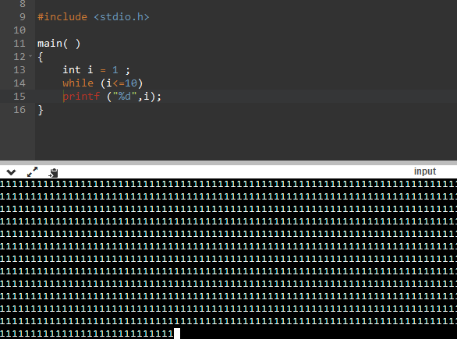
while loop
This is an infinite loop as i becomes fixed to 1

Slide 12
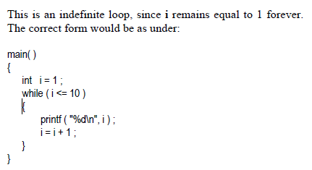
while loop-C program to print 1st 10 Natural Numbers
The correct form would be as under

Slide 13
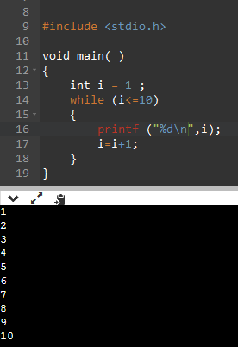
while loop-C program to print 1st 10 Natural Numbers
The correct form would be as under

Slide 14
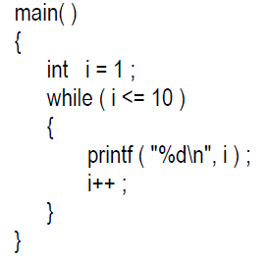
increment operator i++
increments the value of i by 1, every time the statement i++ gets executed.

Slide 15
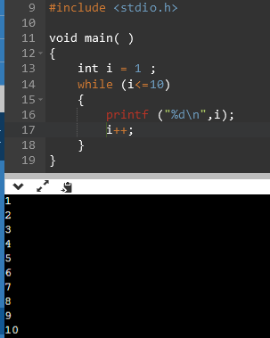
increment operator i++
increments the value of i by 1, every time the statement i++ gets executed.

Slide 16
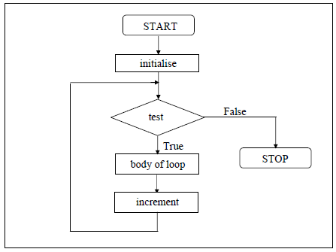
for loop
Syntax:-
for ( initialise counter ; test counter ; increment counter )
{
do this ;
and this;
}

Slide 17
for loop
The for allows us to specify three things about a loop in a single line.
Setting a loop counter to an initial value.
Testing the loop counter to determine whether its value has reached the number of repetitions desired.
Increasing the value of loop counter each time the program segment within the loop has been executed.

Slide 18
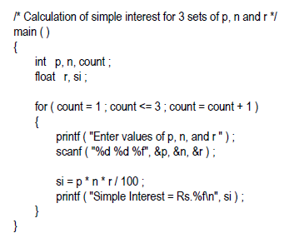
for loop

Slide 19
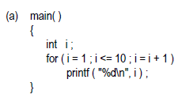
for loop
Note that the initialisation, testing and increementation of loop counter is done in the for statement itself.
Instead of i = i + 1,
the statements i++ or i += 1 can also be used.

Slide 20

Output-
Code-
#include<stdio.h>
int main()
{
int i=0;
for(i=1;i<=10;i++)
{
printf("%d \n",i);
}
return 0;
}

Slide 21

Code-
Output-
#include <stdio.h>
int main()
{
int j, sum = 0;
printf("The first 10 natural number is :\n");
for (j = 1; j <= 10; j++)
{
sum = sum + j;
printf("%d ",j);
}
printf("\nThe Sum is : %d\n", sum);
}

Slide 22
C program to print natural numbers in reverse from n to 1
#include <stdio.h>
int main()
{
int i, start;
printf("Enter starting value: ");
scanf("%d", &start);
for(i=start; i>=1; i--)
{
printf("%d\n", i);
}
return 0;
}

Slide 23
C program to print all even nos from 1 to n
#include <stdio.h>
int main()
{
int i, n;
printf("Print all even numbers till: ");
scanf("%d", &n);
printf("Even numbers from 1 to %d are: \n", n);
for(i=1; i<=n; i++)
{
if(i%2 == 0)
{
printf("%d\n", i);
}
}
return 0;
}

Slide 24
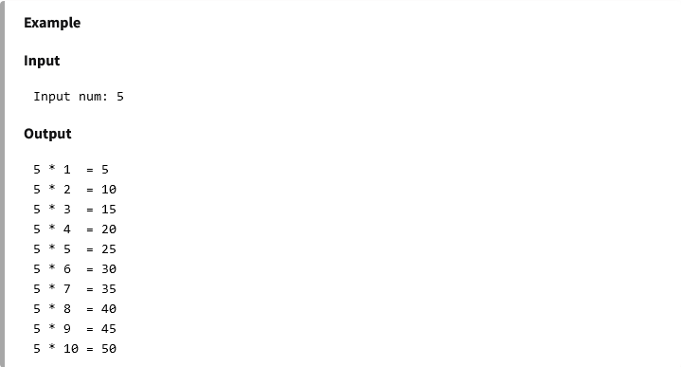
C program to print multiplication table of a given number

Slide 25
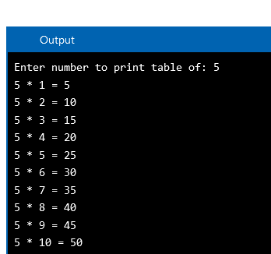
C program to print multiplication table of a given number
Output-
#include <stdio.h>
int main()
{
int i, num;
printf("Enter number to print table: ");
scanf("%d", &num);
for(i=1; i<=10; i++)
{
printf("%d * %d = %d\n", num, i, (num*i));
}
return 0;
}

